Slide 1




Employee Attrition Control
Team Name: Data Miners
Semester: Spring 2020
Dishti Dave
CS513-B
Computer Science Graduate Student
Dyuti Dave
CS513-B
Computer Science Graduate Student
Eman Alofi CS513-B
Software Engineering Graduate Student
Vaishnavi Gopalakrishnan
CS513-B
Computer Science Graduate Student
Instructor : Prof. Khasha Dehnad

Slide 2
Overview
What is Attrition?
Gradual loss of employees over time
Leads to high cost for an organization
Common expenses of losing employees and replacing them
Job postings
Hiring process
Paperwork, and
New hire training
Additionally, regular employee turnover prohibits your organization from increasing its collective knowledge base &experience over time.
Customers often prefer to interact with familiar people.
Errors and issues are more likely if you constantly have new workers.

Slide 3
Problem description
Goal
To show that companies can recognize the employees that are going to quit
Help the company to make them stay
Provide factors to the company with which they can improve the employees' satisfaction

Slide 4
Problem description
Summary
Predict how many people from the company would quit - Status
Factors considered
Annual Rate
Hourly Rate
Job code
Job satisfaction score
Age
Performance rating
Performed data preparation, data analysis & data modelling.
Developed machine learning models to predict the attrition.
Only 56.12% of total employees are active in the original dataset.

Slide 5
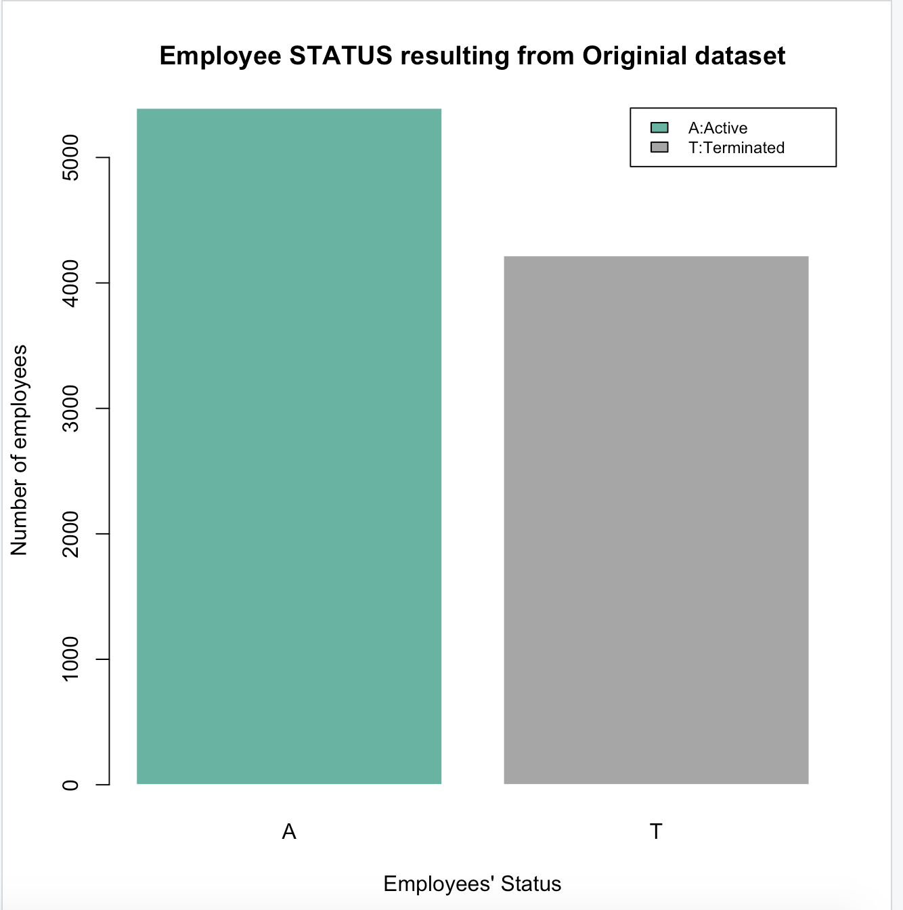
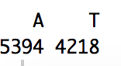
Analysis of Dataset
Uni Variant Analysis – Bar Graph
Depicts the status of employees from the Original dataset
Active – 5394 / 9612 = 56.12%
Terminated = 4218 / 9612 = 43.88%

Slide 6
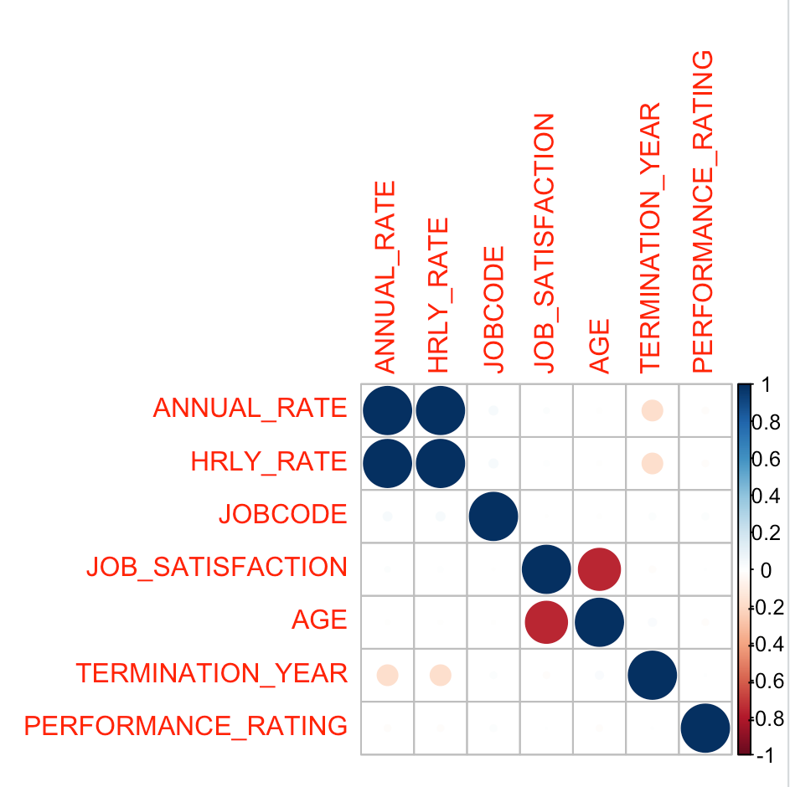
Analysis of Dataset
Multi Variant Analysis - Correlation
Depicts correlation between various
factors considered.
> Annual rate & Hourly Rate
> Job Satisfaction & Age
The above factors correlates more with
each other

Slide 7
Approaches / Techniques Used
Supervised Learning Techniques
a) kNN - Eman
b) kkNN - Vaishnavi
Naïve Bayes - Dishti
Decision Tree - Eman
Linear Regression - Vaishnavi
SVM - Dyuti
ANN – Eman & Vaishnavi
Random Forest - Dishti
C5_0 - Dishti
Unsupervised Learning Techniques
K-means - Dyuti
H-clustering - Dyuti

Slide 8
Solution
Read the data set
Analysed the data for null values
Converted data based on the algorithm requirement
Normalized the data for certain algorithms
Applying supervised & unsupervised learning algorithms
Train the data
Predict the status of the employees
Created visualization for some models

Slide 9
Supervised Learning
What?
Concept of function approximation
Model relationships and dependencies between the target prediction output and the input features
We can predict the output values for new data based on those relationships
Predictive model
Have labelled data
Deals with Regression & Classification problems

Slide 10
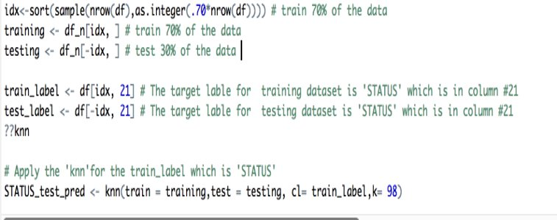
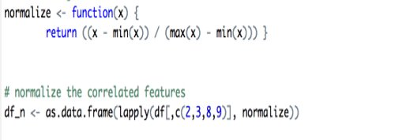
Supervised Learning
kNN - k-Nearest Neighbor
The data points are predicted based on how its nearest neighbor data are classified.
The target variable is the "status" of the employee based on the most correlated features which are :
Annual rate & Hourly Rate
Job Satisfaction & Age
The value of K is 98 which is the square root of number of rows in the dataset.
9612^(0.5) = 98.04
Accuracy ~ 57%

Slide 11
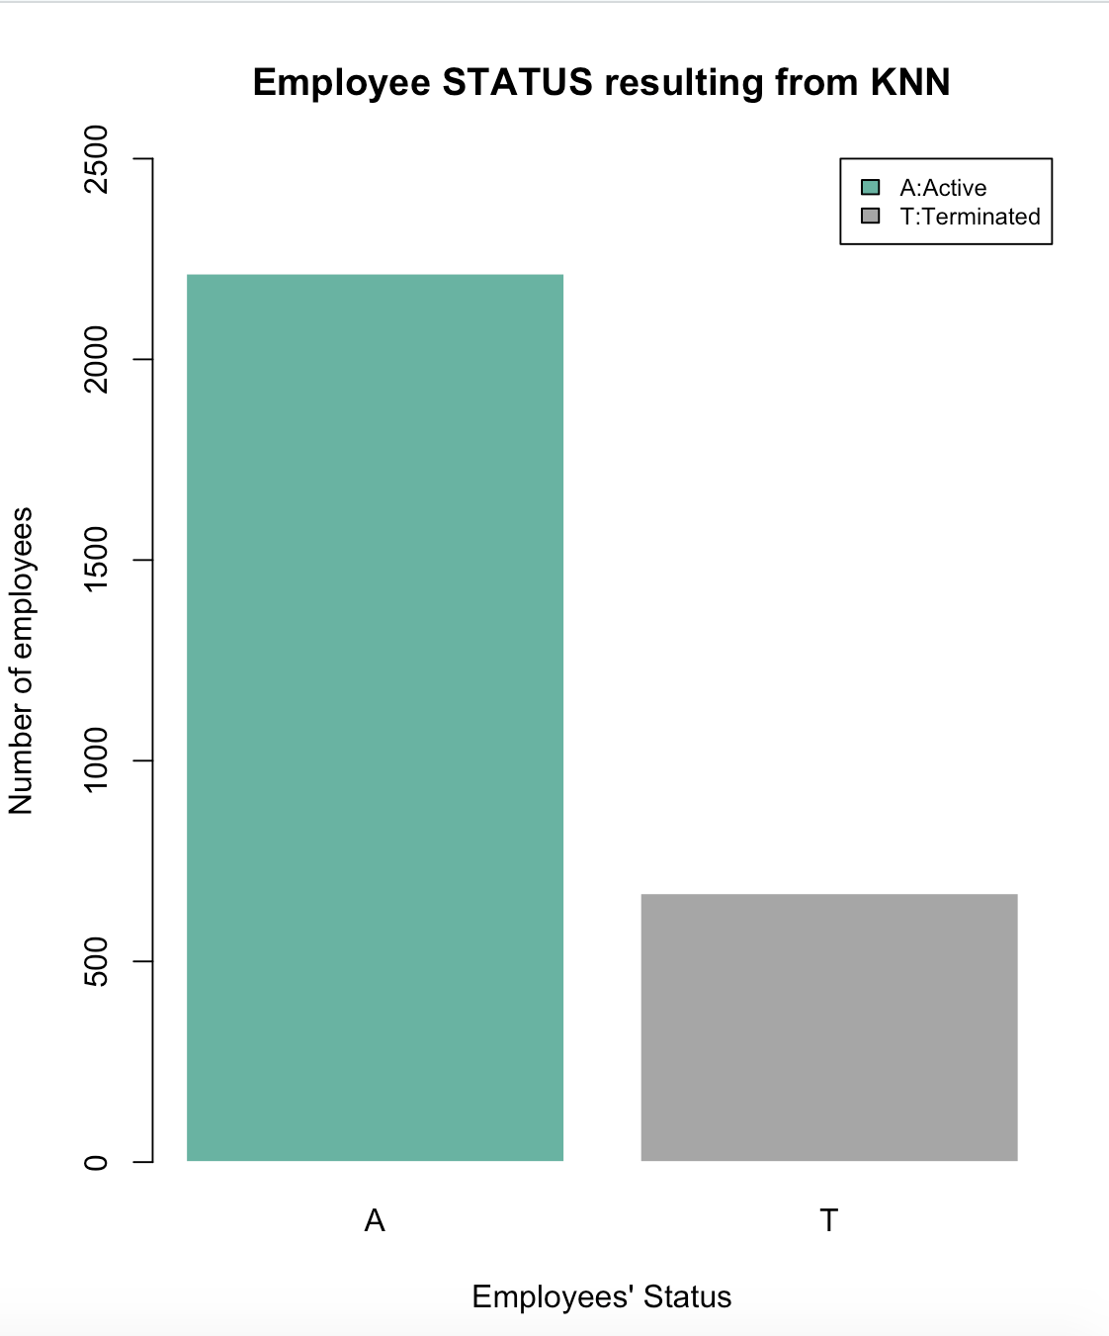
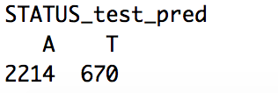
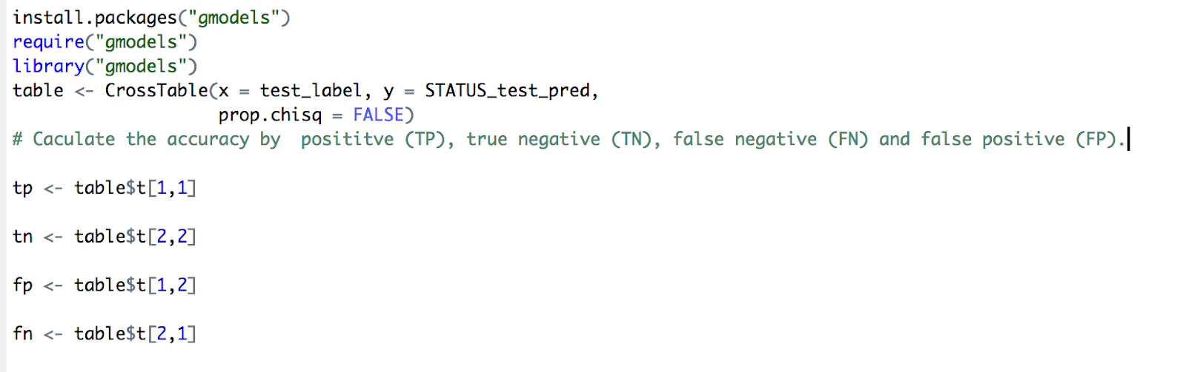
Visualization of predicted kNN
Depicts the status of employees from kNN prediction
Total data tested = 2884 (30% of original dataset)
Active employees = 76%
Terminated employees = 24%

Slide 12
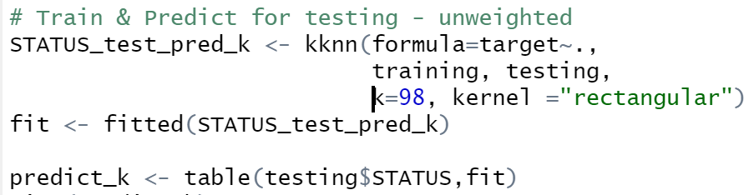
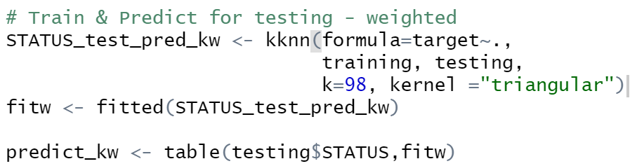
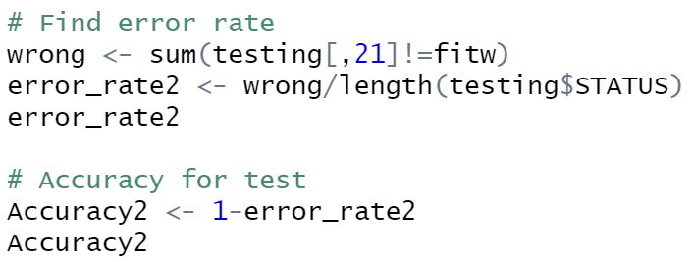
Supervised Learning
kkNN
Accuracy for
Unweighted kkNN ~ 99.65%
Weighted kkNN ~ 99.69%

Slide 13
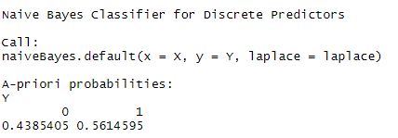
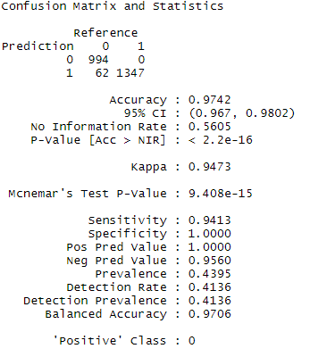


Supervised Learning
Naïve Bayes
A Naive Bayes classifier considers each of these features to contribute independently to the prediction, regardless of any correlations between features.
Accuracy ~ 97.42%
It requires less training data and when assumption of independence hold it performs better compared to other models.
Perform well for categorical input
Insert charts if any

Slide 14
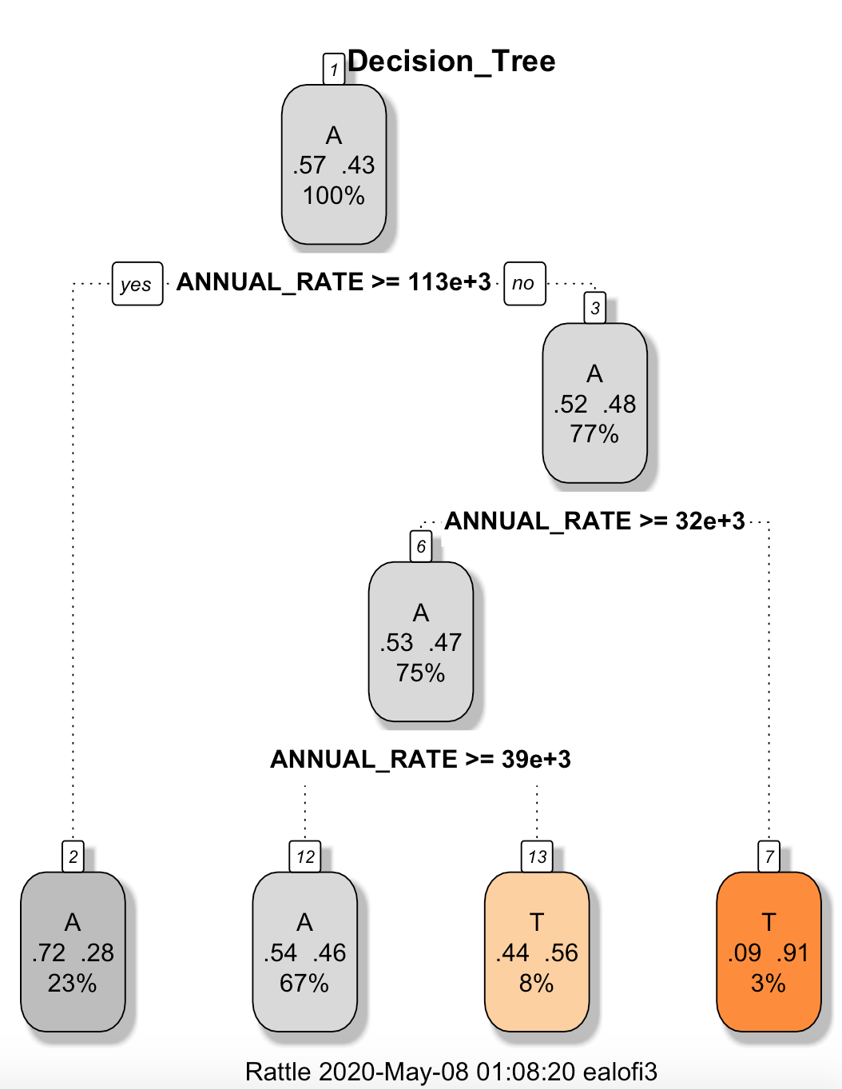
Supervised Learning
Decision Trees
Classification And Regression Tree
Tree that represents choices and their results.
Nodes are choices
Edges are decisions
Accuracy ~ 59.1%
Output

Slide 15
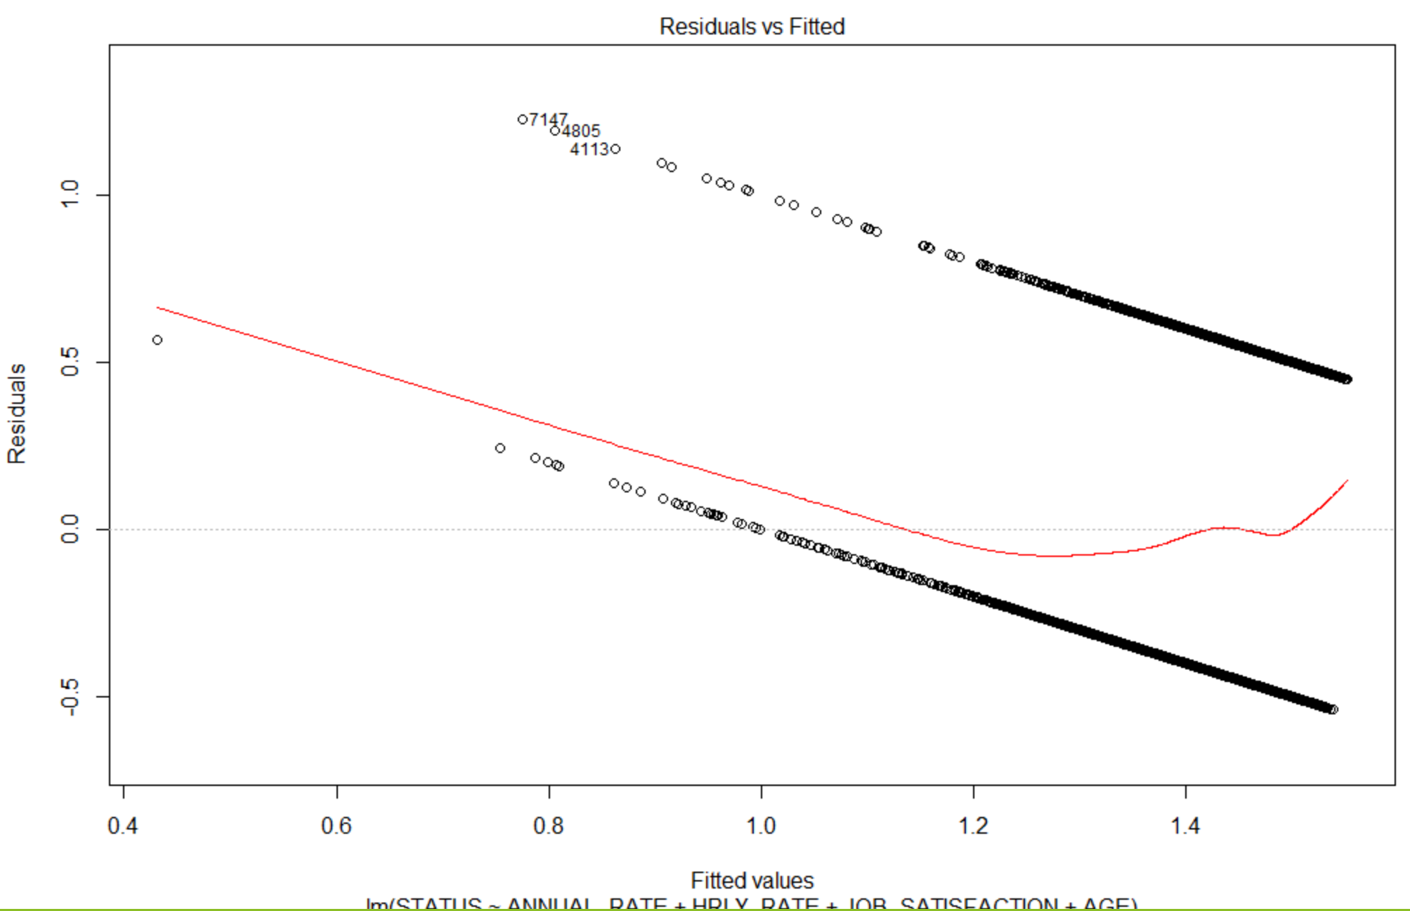
Supervised Learning
Linear Regression
Predict values for continuous variables based on one or more predictor variables
Plots are made from the residuals
Accuracy ~ 96.5%

Slide 16
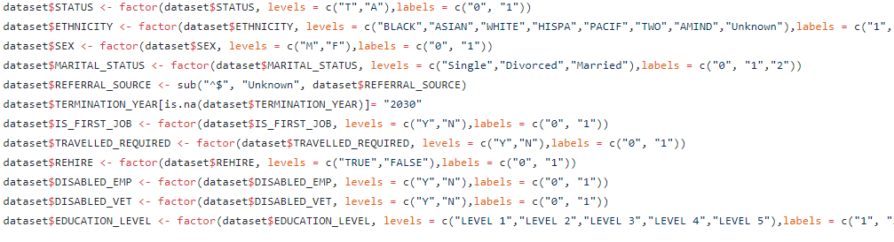
Supervised Learning
Support Vector Machines (SVM)
SVM is a discriminative classifier that takes labelled training data and constructs a hyperplane to categorize new examples.
It looks at the interaction between future points.
The idea behind SVM is to optimize the decision boundary that separate classes for prediction
Accuracy ~ 52%
Code Snippet for EDA of Sample

Slide 17
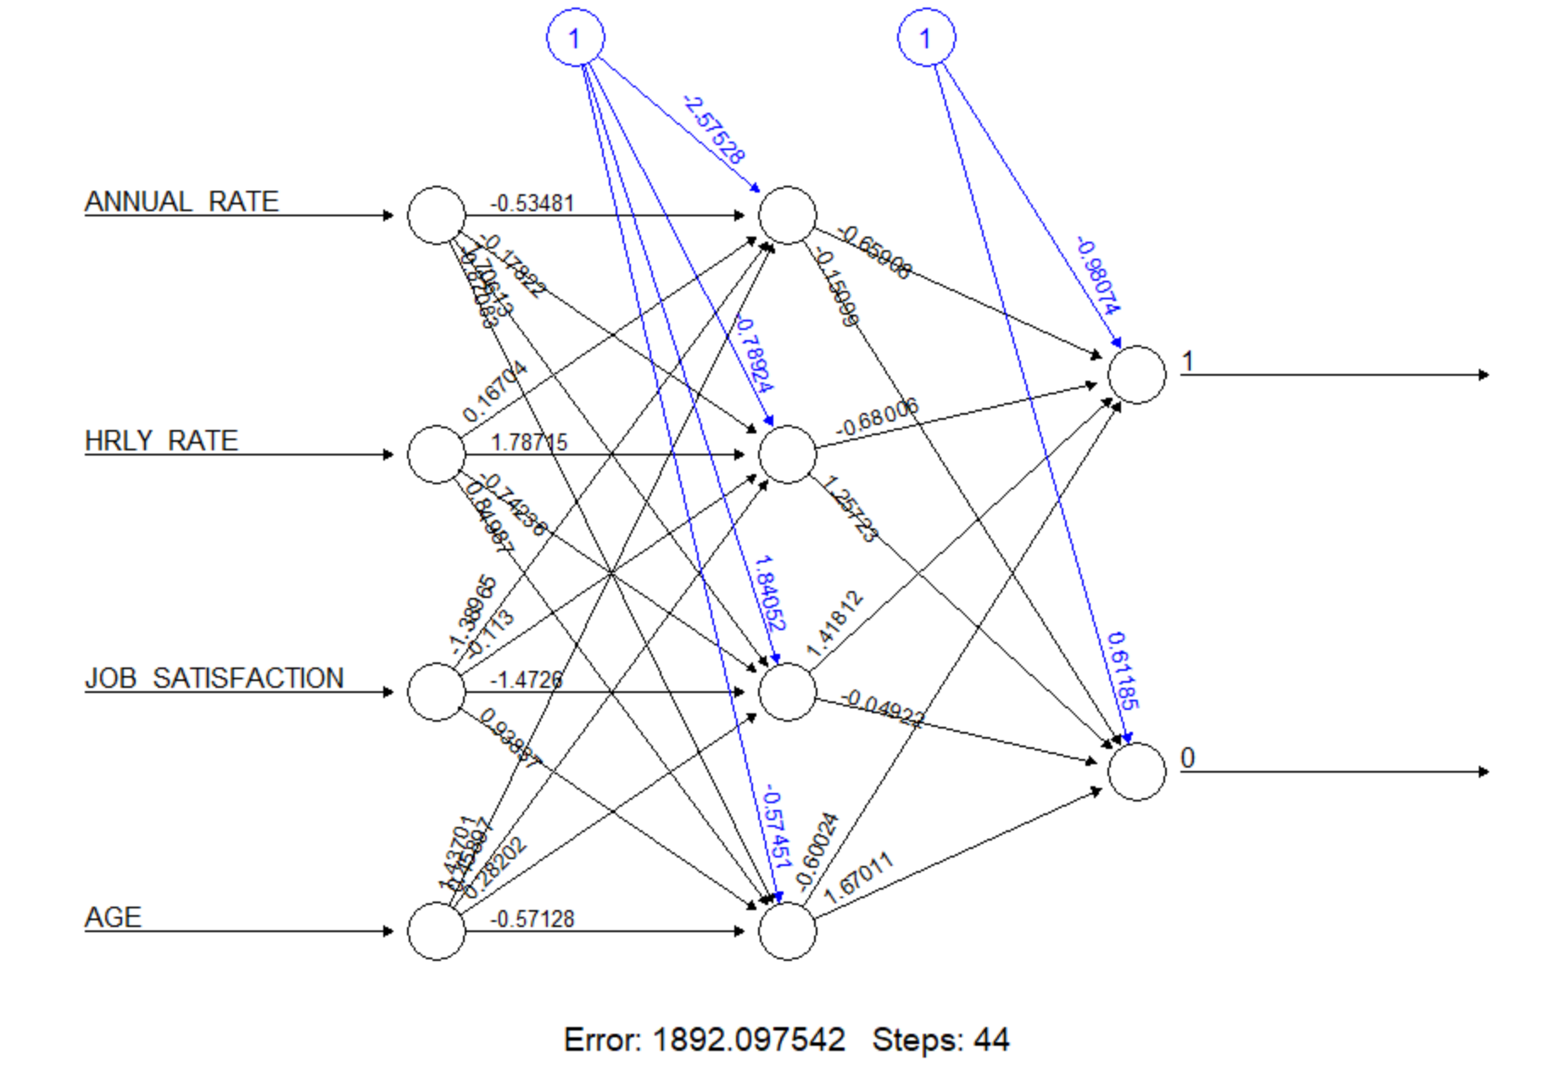
Supervised Learning
Artificial Neural Net
Stimulate the behaviour of biological system composed of neurons
Inspired by animal's central nervous system
Accuracy ~ 50%

Slide 18
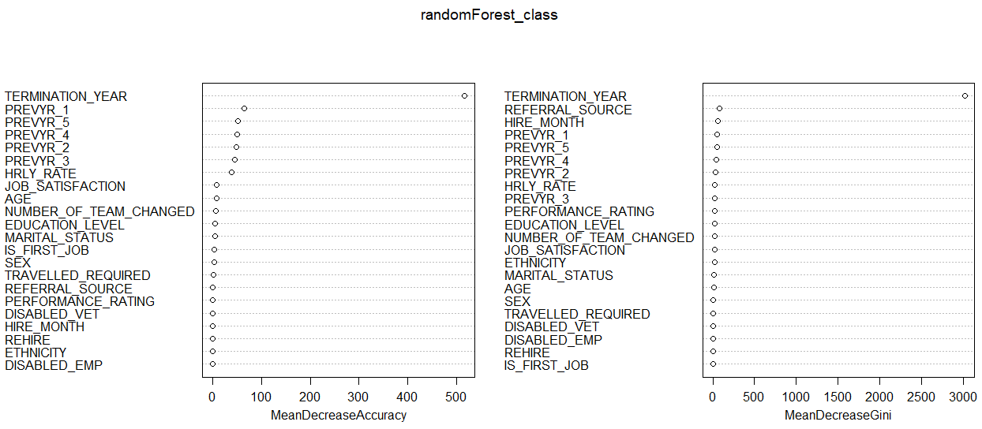
Supervised Learning
Random Forest Feature Importance graph
It improves on bagging because it decorrelates the trees with the introduction of splitting on a random subset of features.
"RANDOM" because each tree is only trained on a random subset of samples drawn from the training set. Accuracy ~ 99%

Slide 19
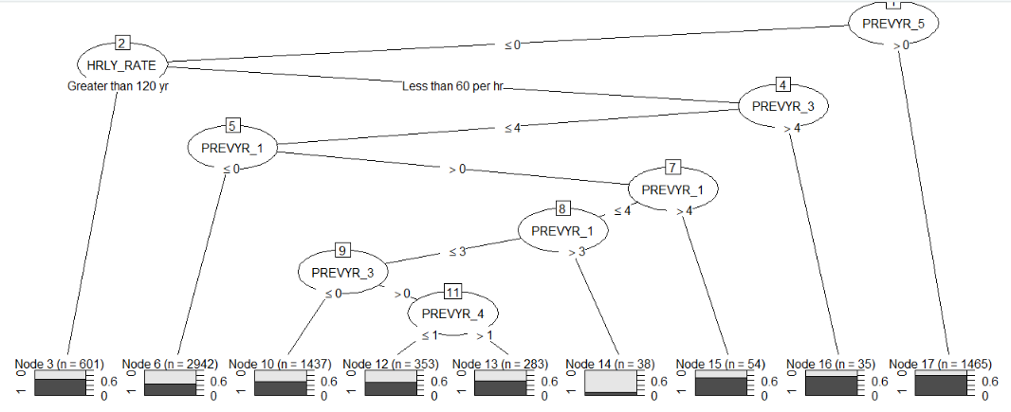
Supervised Learning
C5.0
It works by splitting the sample based on the field that provides the maximum information game.
C5.0 gives a binary tree or multi branch tree. Accuracy ~ 63.25%

Slide 20
Unsupervised Learning
What?
Concept of pattern detection
Mine the data for rules, detect patterns, summarize & group the data points
Trained with unlabelled data
Descriptive model
Deals with Clustering & Association rule learning

Slide 21
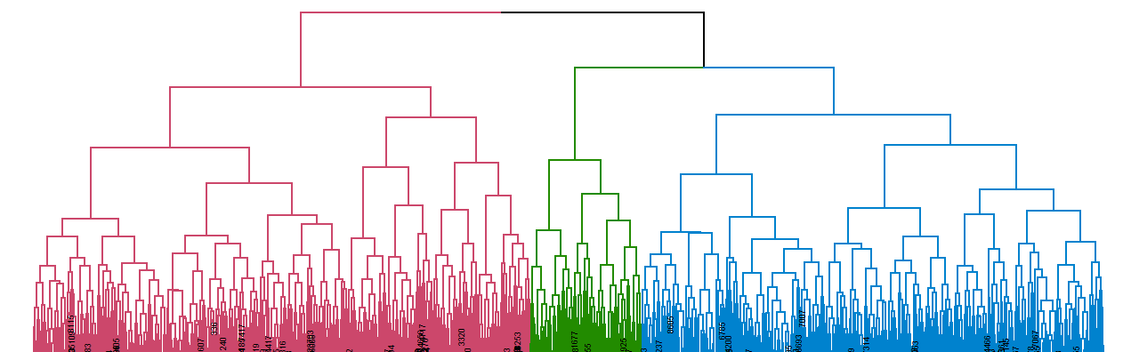
Unsupervised Learning
h-clustering Dendrogram for cut = 3 obtaining 3 clusters of our dataset solution
H-clustering has advantage that any valid measure of distance can be used.
It uses a powerful technique to build tree structures from data similarity
It only uses matrix of distances which implies that the observation themselves are not required.
Accuracy ~ 56%

Slide 22
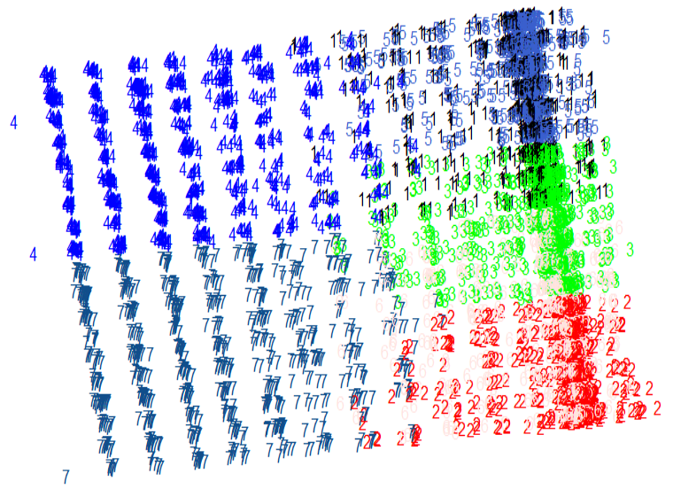
Unsupervised learning
k-means cluster plot for k=7
Used when you have unlabelled data. It becomes a great solution for pre-clustering, reducing the space into disjoint smaller sub-spaces where other clustering algorithms can be applied
K identifies the number of centroids and then allocates every data point to the nearest cluster.
Accuracy 48%

Slide 23
Recommendations
Based on predictions & visualizations
Most of all we found factors which are most important to employees and if they are not fulfilled, it might lead
to Attrition.
Based on the predictions, the company must be able to figure out the affecting factors and correct them to
Control attrition.

Slide 24
Conclusion & Future Work
Conclusion
Machine learning models are as good as the data you feed, and more data would strengthen the model.
While some level of attrition is inevitable it should be kept at the minimum possible level using above solution.
Based the most important features to the least important features we can identify what are the main causes for attrition.
It helps to understand the key variable that influence the turnover.
We have considered every selective group of features to identify what works best for our dataset and analysed our model solution
Future Work
New machine learning techniques can be applied to business application and especially predictive analytics.
In this case we can use H2O/LIME to develop and explain sophisticated models that very accurately detect employees that are at risk of turnover.
Or advanced machine learning models and selective features can help improve our predictive analysis. Using ensemble model to breakdown complex structure into critical features that most related to attrition

Slide 25
GitHub Repository:
https://github.com/vaishnavimecit/CS513Spring20_DataMiners
Thank You

